Slide 1
Applying Conventional Navajo Knowledge when investigating DRUM sites within the Navajo Nation
Mikayla Bia
‘22 MES Intern
Site: Grand Junction Dept. of Energy

Slide 2
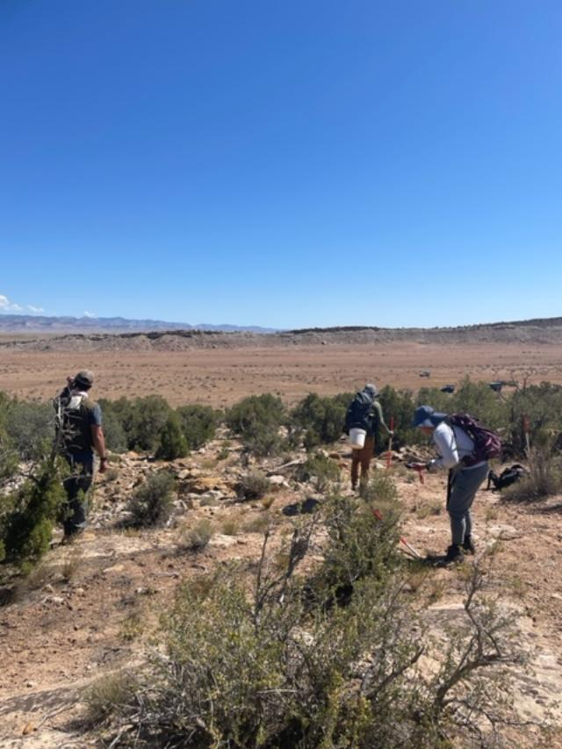
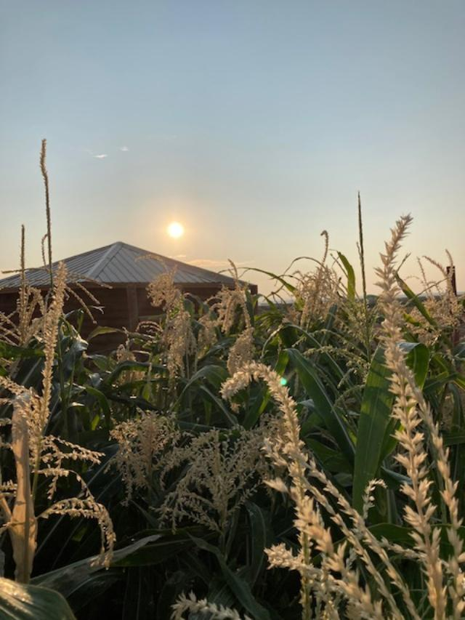
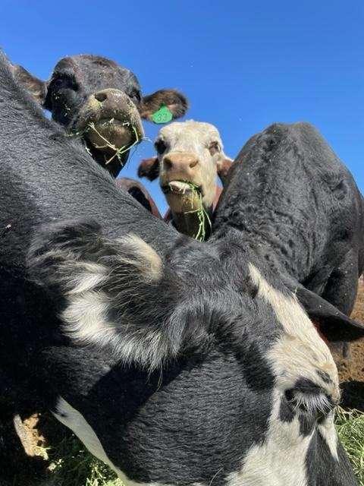
Mikayla Bia
Hometown: Many Farms, AZ
Education: Sophomore – Dine College
Tsaile, AZ
Major : Environmental Engineering
Internship site: Office of Legacy Management (LM)
Grand Junction, CO

Slide 3
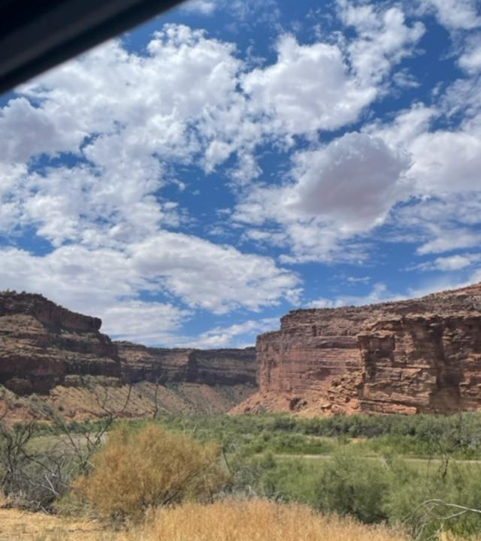
What is DRUM?
Defense-Related Uranium Mines (DRUM) Program - partnership between DOE, land managers, and abandoned mine land agencies
Performing Verification & Validation
Inventory mine features, collecting gamma surveys, soil samples, and ecological data
Reports the physical, chemical and radiological hazards present at a site

Slide 4
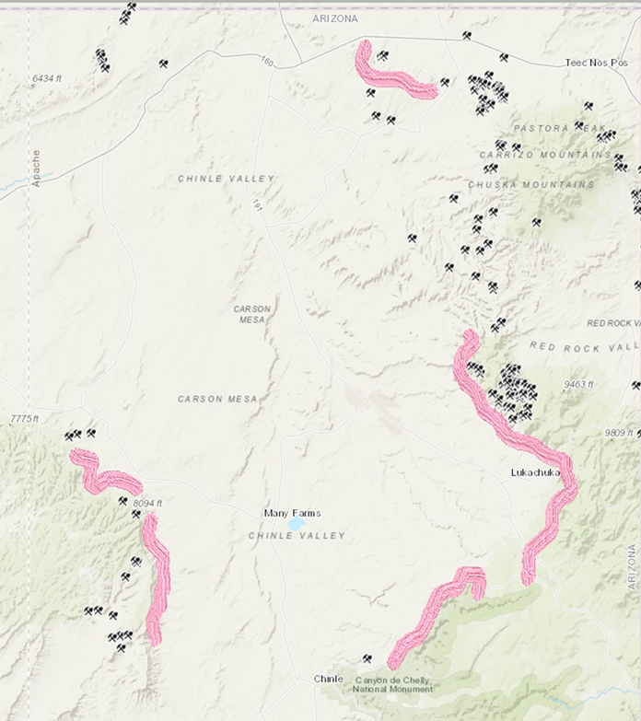
Observation of plants and animals within each of the 5 agencies within the Navajo Nation
Chinle Agency
Eastern Navajo Agency
Fort Defiance Agency
Shiprock Agency
Western Navajo Agency

Slide 5
Applying the relationship between the Dine Education Philosophy (DEP) and LM’s EMS Framework
LM’s framework
Dine Educational Philosophy

Slide 6
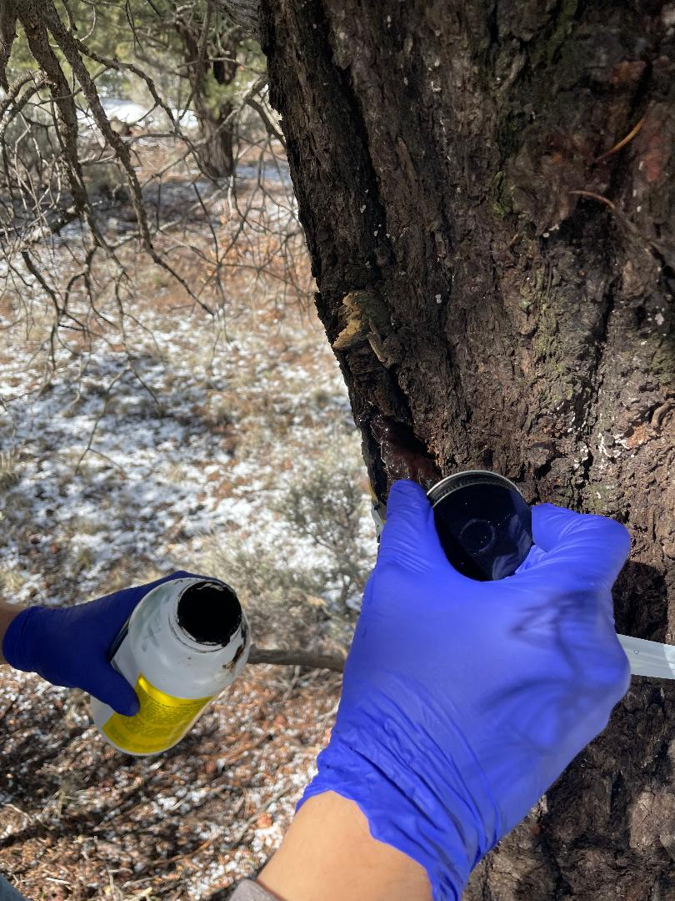
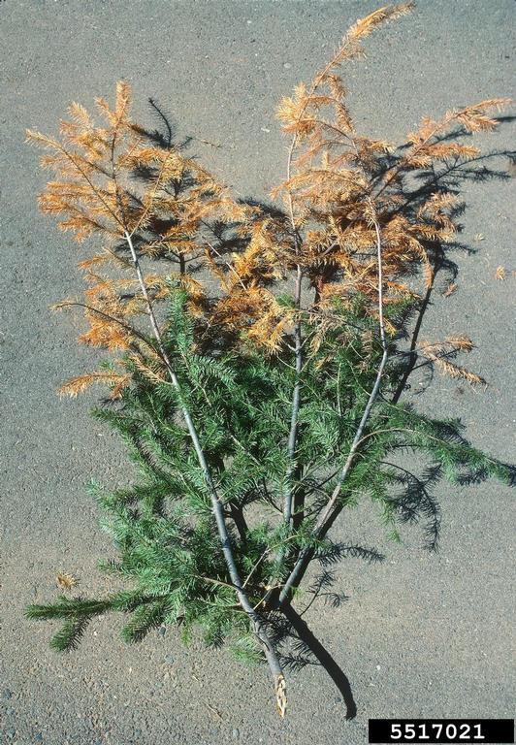
Ndischii’ (Ponderosa Pine)

Slide 7
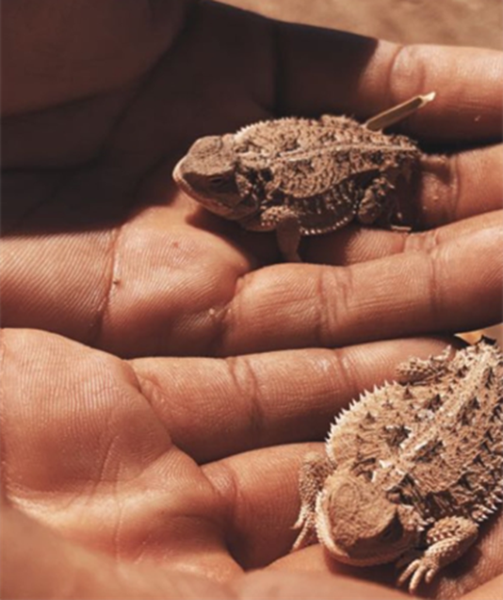
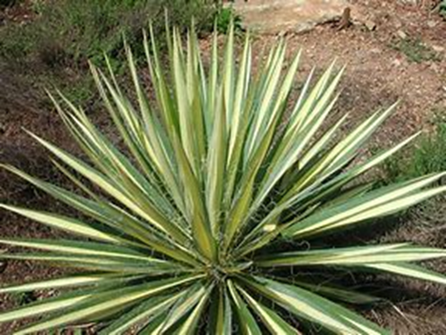
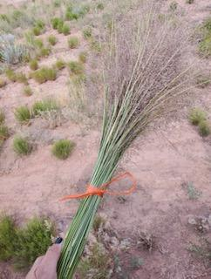
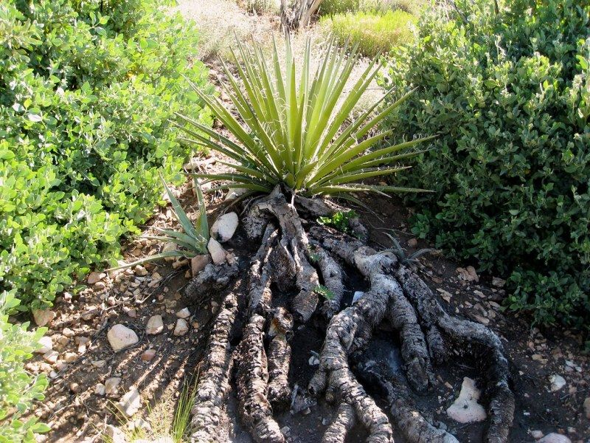
Na’ashoo’ii dich’izhii
(Horned Toad)
Tsa’aszeh
(Yucca plant)
Tl’ohtsohzhoo’
(dropseed grass)

Slide 8
The Pre College-University partnership with Legacy Management has helped me learn about the different areas of environmental engineering. With the involvement of my mentors and those I had daily interaction with I was highly encouraged to involve my traditional knowledge within assignments that lead to the production of my summer research. I then was able to intertwine the different guides and share their same intentions. This is an experience that taught me the importance of involvement. Becoming involved and willing to expand my knowledge so that I too can later help educate others. For the benefit of all.
ahéhee’ (THANK YOU)

